Slide 1
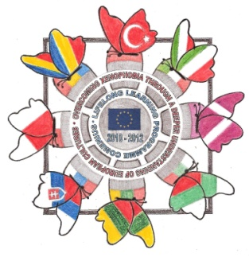
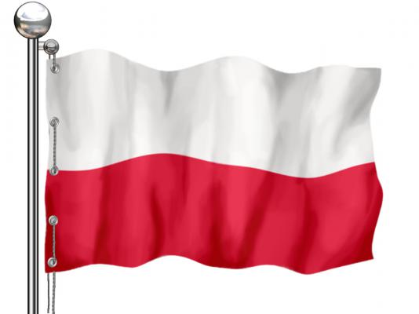
NATIONAL HOLIDAYS
IN POLAND

Slide 2
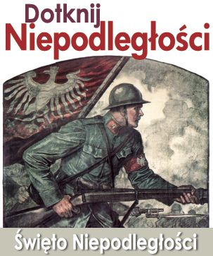
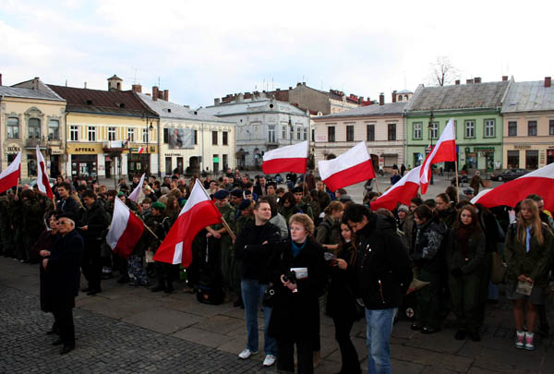
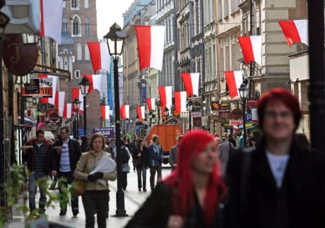
National Independence Day
Polish Independence Day is a public
holiday in Poland celebrated every year on 11th November.
It marks the restoration of Poland's independence in 1918. After 123 years of partitions by Russia, Prussia and Austria Poland reappeared on the map of Europe as a sovereign democratic state.

Slide 3
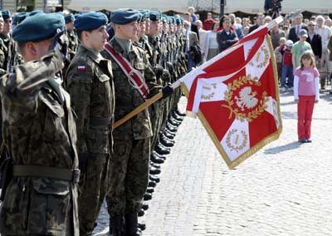
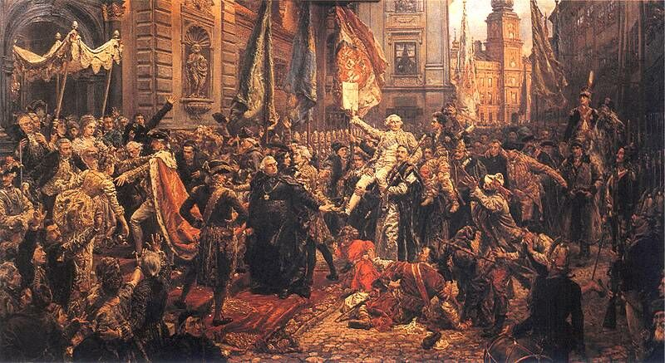
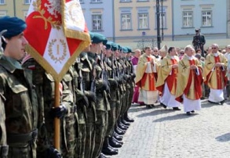
3rd May Constitution Day
Year after year, The Polish community, whether at home or abroad, gathers together to commemorate the 3rd of May Constitution and to honor all the great minds who took part in the creation of this revolutionary document in 1791. They celebrate because the constitution symbolizes the spiritual and moral renovation of the Polish nation after a long period of chaos and disorder. They celebrate because the constitution established a democratic philosophy of humanitarianism and tolerance, including entire liberty to all people. And, most of all, they celebrate because the 3rd of May Constitution is not only a milestone in the Polish political and social history. but it is also a landmark in the European tradition, being the second constitution ever written in the world, and a first on the European soil.

Slide 4
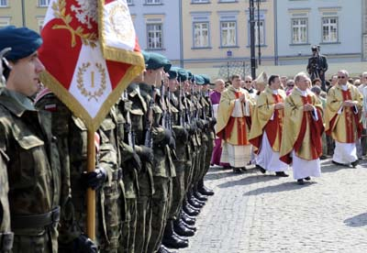
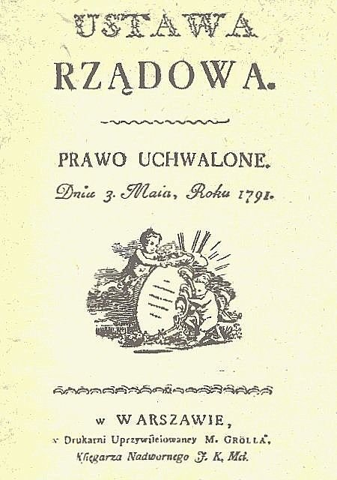
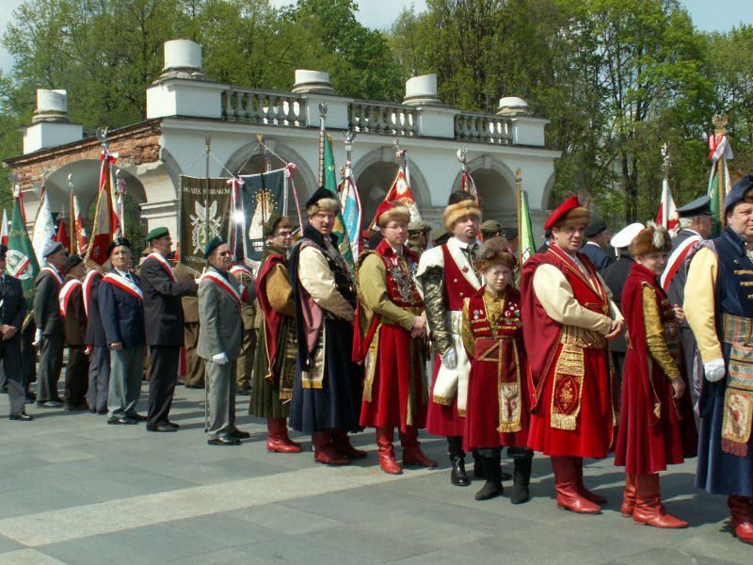

Slide 5
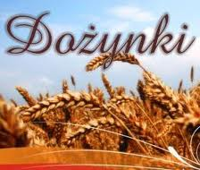
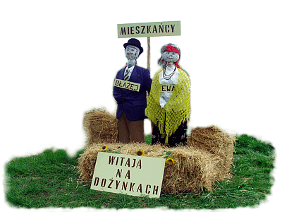
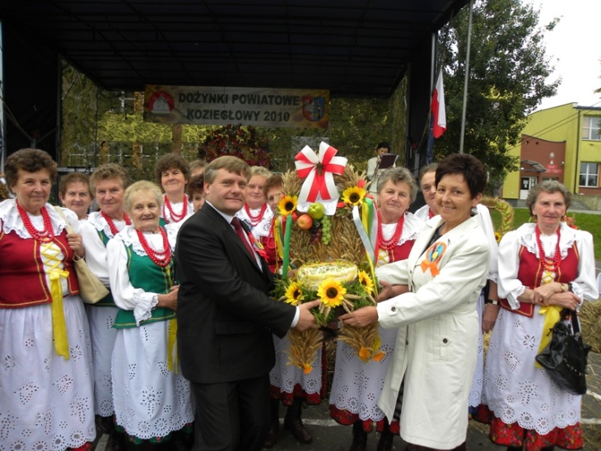
Harvest Celebration - Dożynki
As a country with many agricultural traditions, Poland still continues to celebrate harvest festivals each year from mid-August through mid-September.
Villagers dress in traditional costumes and carry beautifully-made
harvest wreaths.

Slide 6
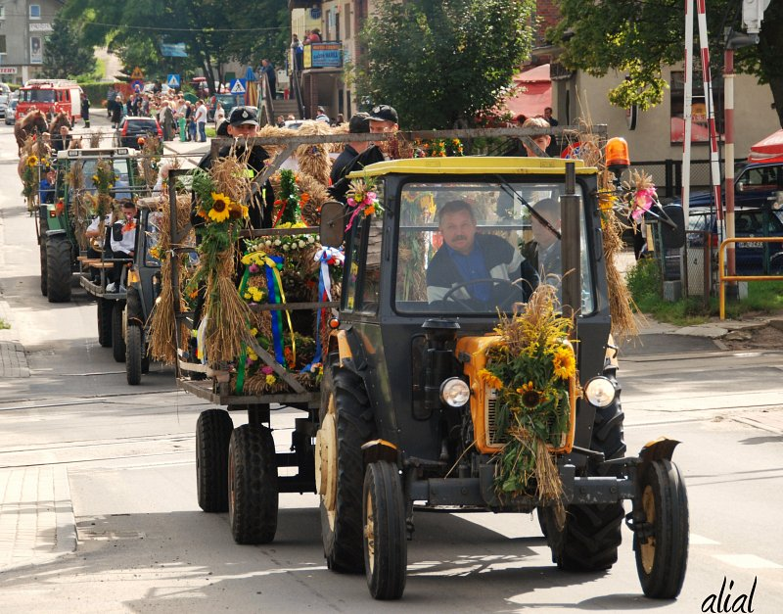
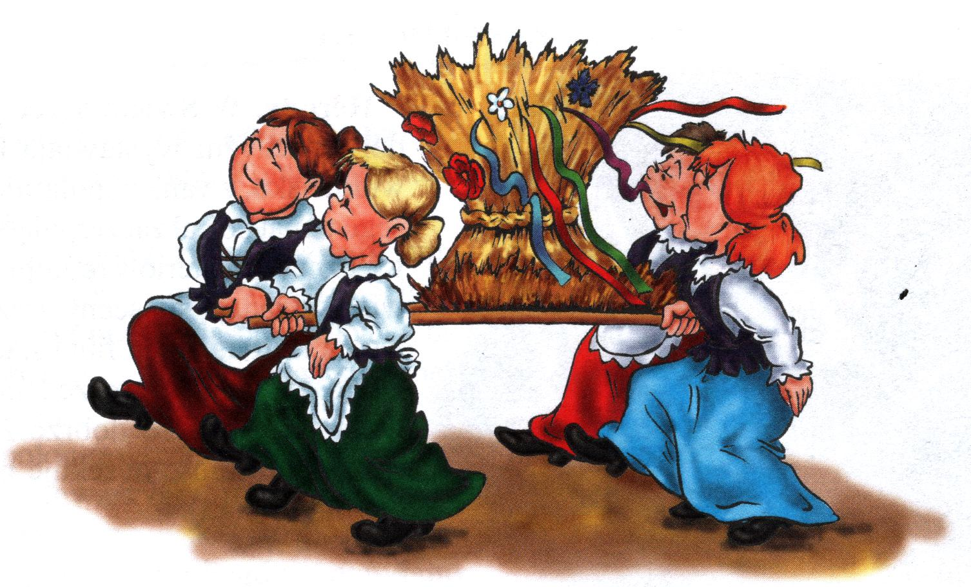
A loaf of bread, baked from
the fresh grain,
is also presented.
The people then
dance and sing
songs in praise
of the harvest.

Slide 7
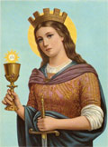
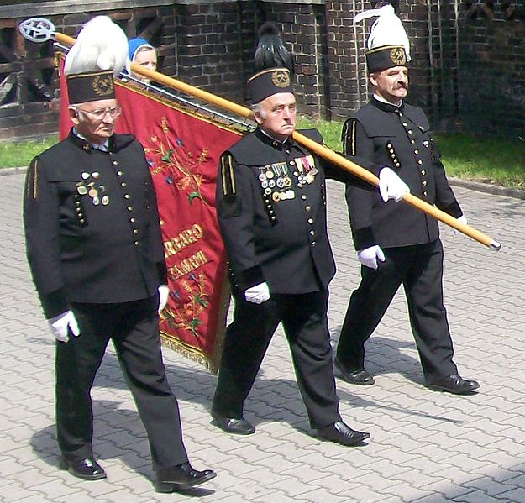
Barbórka - Miners' Day
(St. Barbara’s Day), December 4th
One of the most celebrated days associated with workers group is St. Barbara's Day on December 4th. St. Barbara is a patron of coal miners.

Slide 8
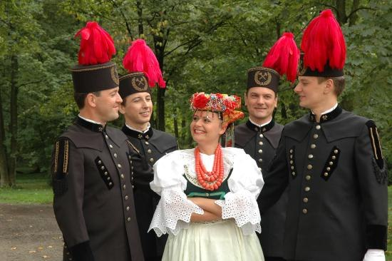
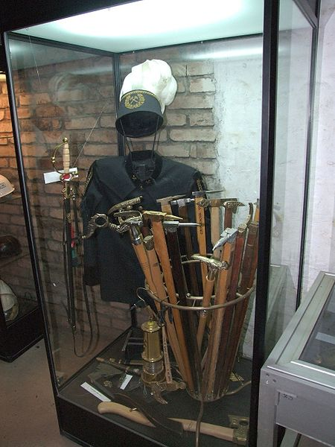
Miners dress in special uniforms during Barbórka. The uniform consists of black suit and hat with a feather. The color of the feather (white, red or black) depends on the rank of the miner. Miners wear their decorative uniforms not only during Barbórka but also for weddings, funerals and other important political or social ceremonies.

Slide 9
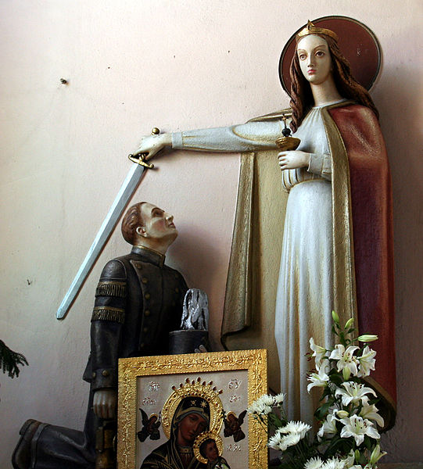
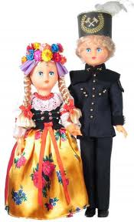
To prevent accidents miners used to build chapels devoted to their patron, St. Barbara. St. Barbara is also a very celebrated nameday in Poland because Barbara is a popular feminine name.

Slide 10
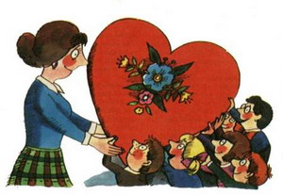
14th OCTOBER - TEACHER’S DAY
We give a lot of flowers to our teachers
and thanks for their work

Slide 11
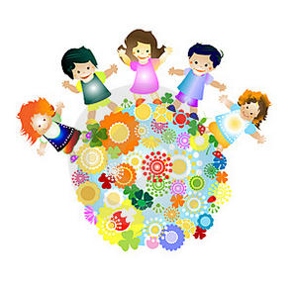
1st JUNE -
CHILDREN’S DAY
Parents give presents and sweets to the children.
All are smiling

Slide 12
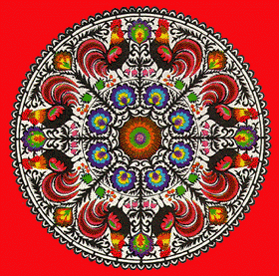
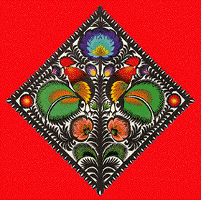
Decorative Paper Cut-Outs From Poland
Polish decorative paper cut-outs are regarded by many as the most beautiful in the world.
They were used to decorate the walls of ceiling beams in countryside cottages and given as gifts to family members and friends.

Slide 13
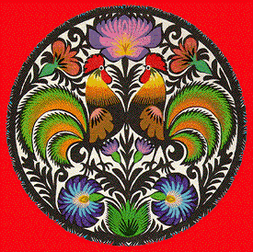
The decorative cut-outs became popular throughout Poland in the middle of the 19th century, and remain a treasured form of Polish folk art.

Slide 14
Thank You

